Slide 1
Welcome to the New Silver Lake Association Website SILVERLAKEPA.ORG
August 2025
For the benefit of all members
Access to Information, improved communication,
sharing of memories, images, stories of Silver lake

Slide 2
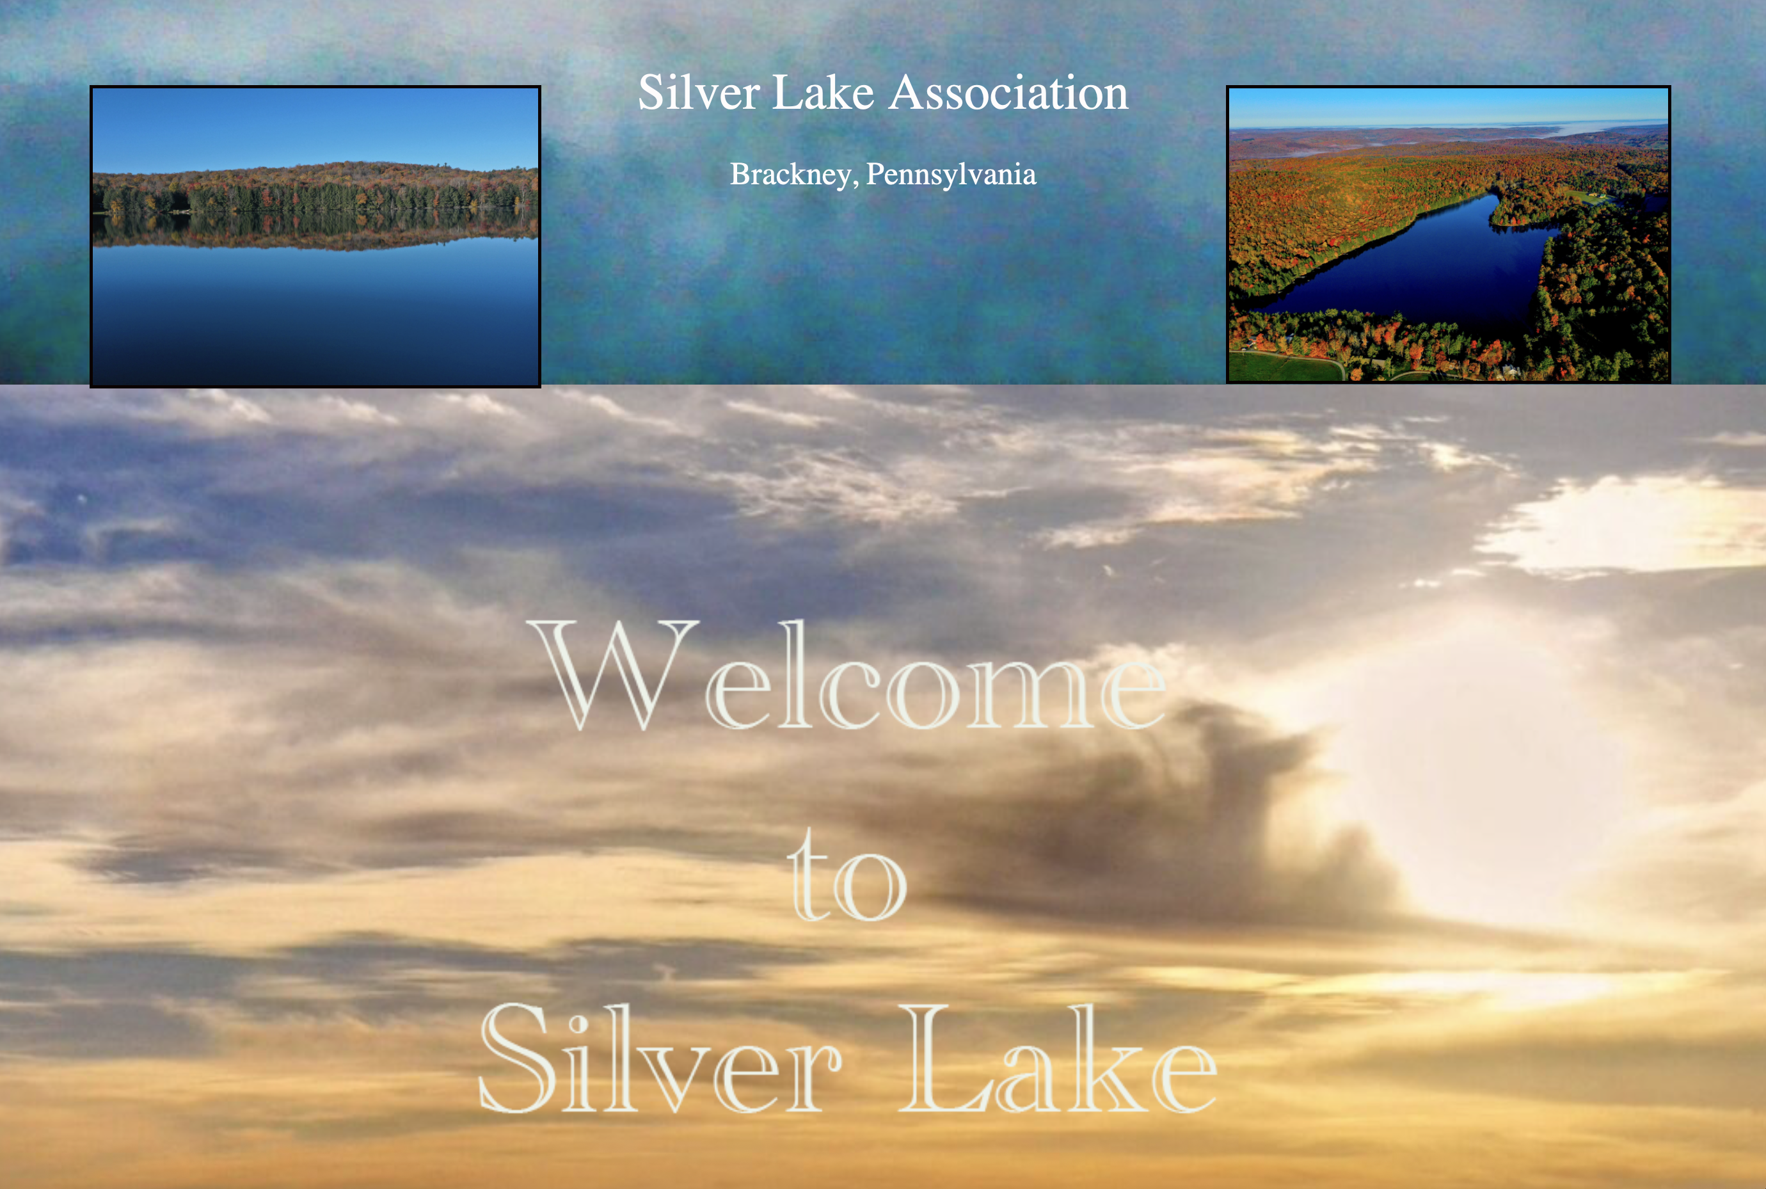

Slide 3
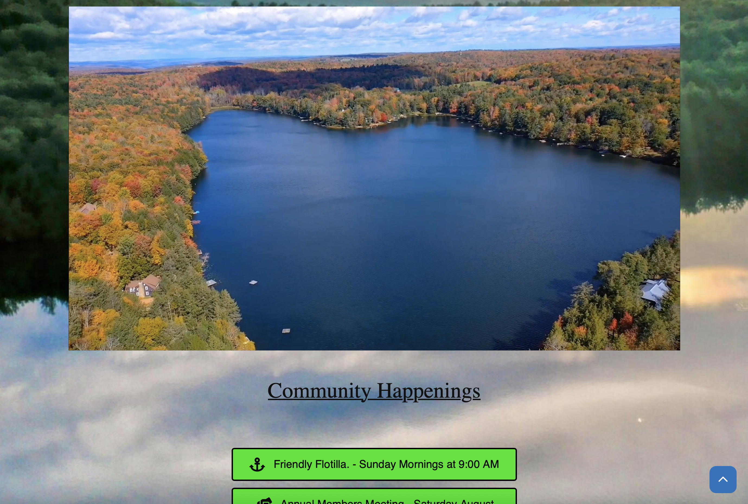
Posting of Events, Activities, and Images/Video

Slide 4
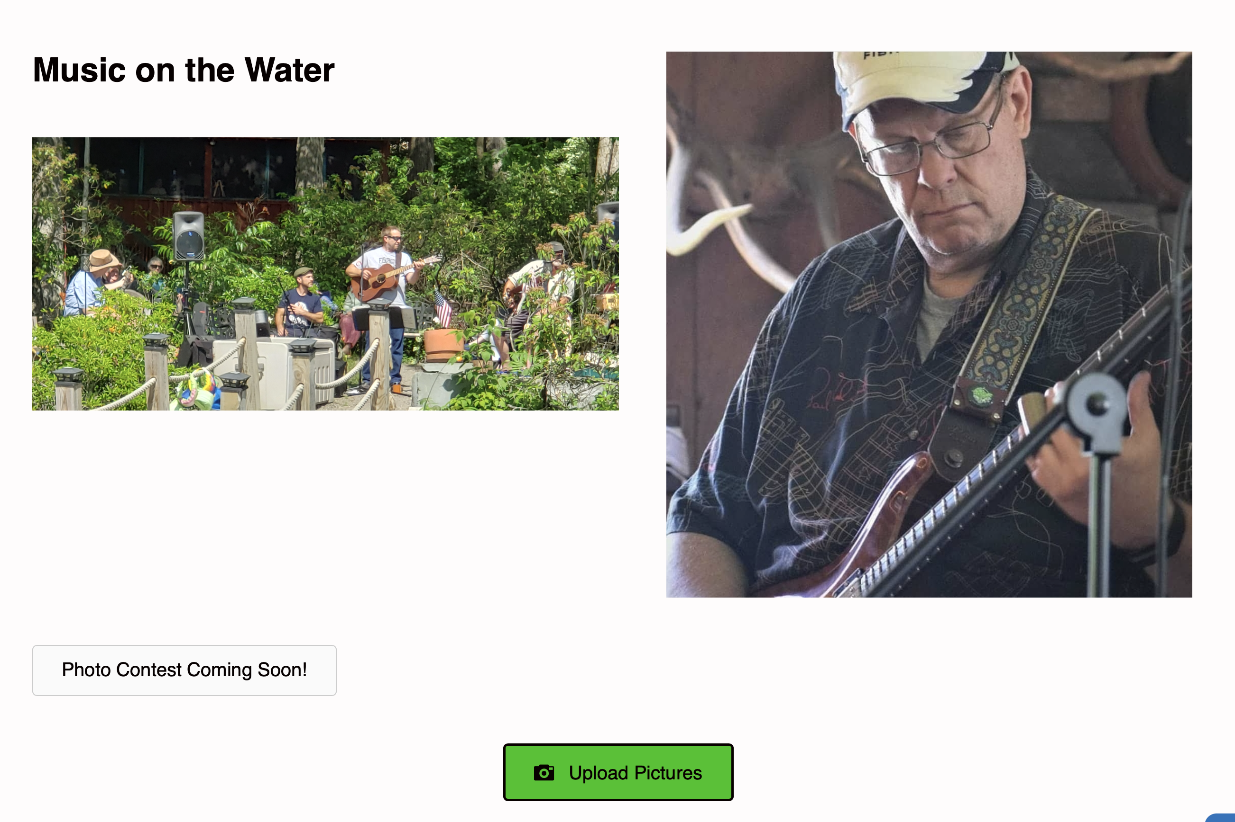
Sharing Events, Upload pictures/video

Slide 5
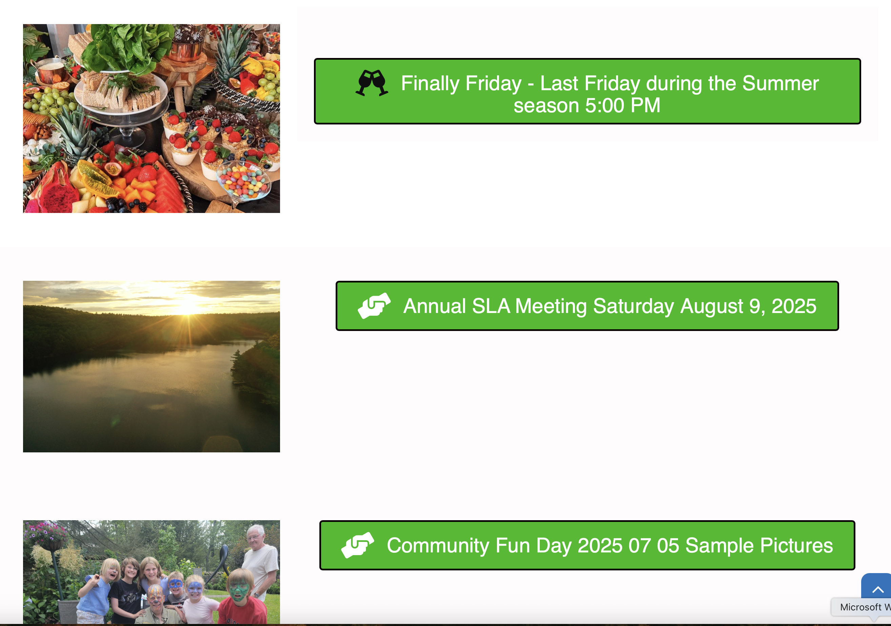
Upcoming Events/Calendar

Slide 6
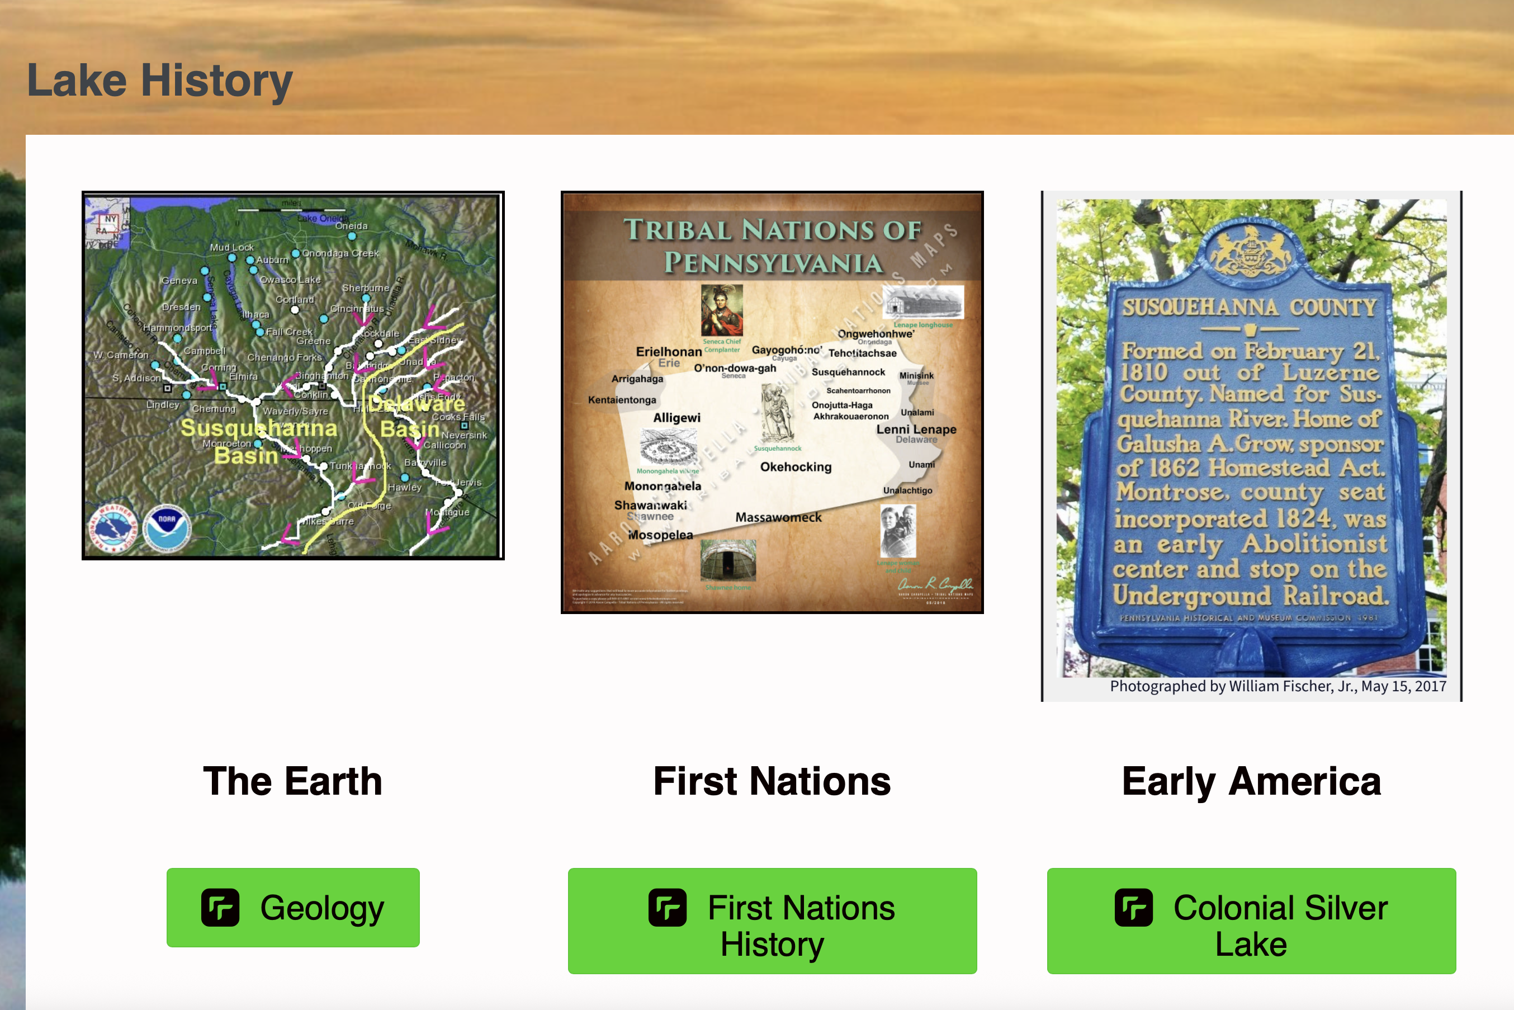
History of Silver Lake

Slide 7
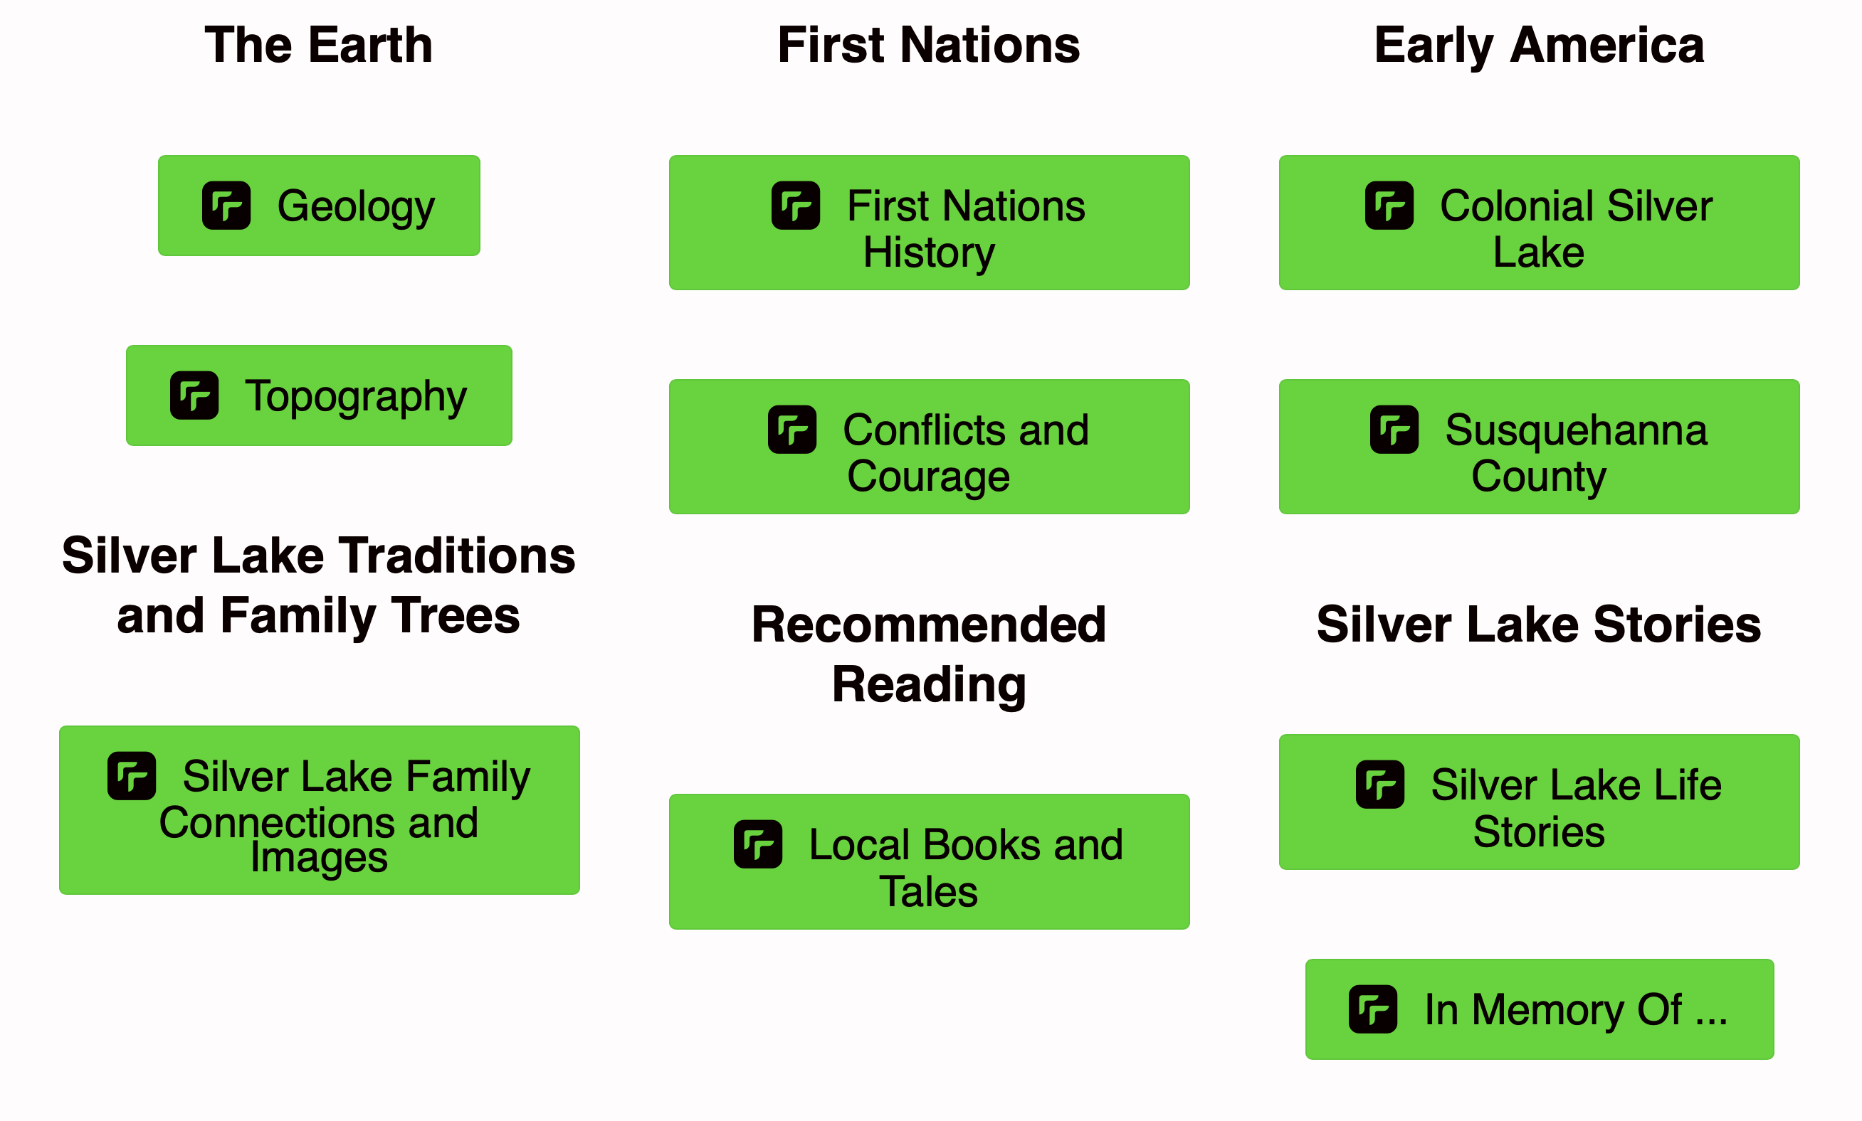
History and Stories of Silver Lake

Slide 8
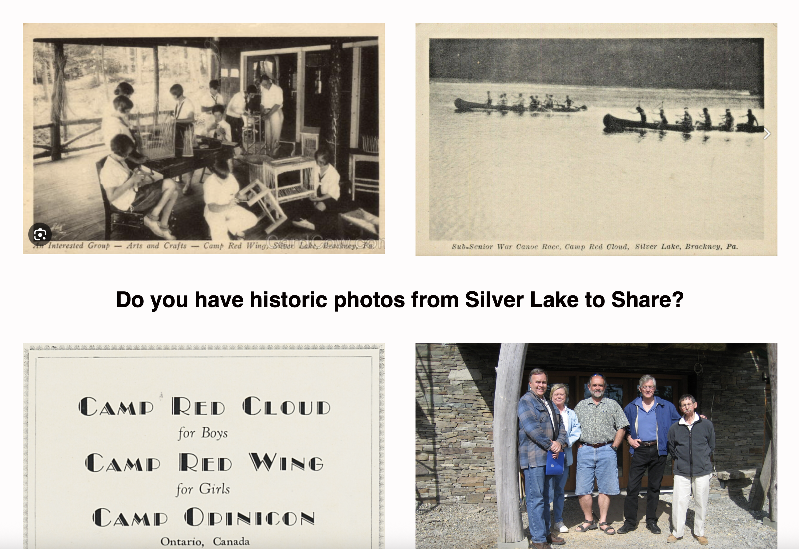
History of Silver Lake

Slide 9
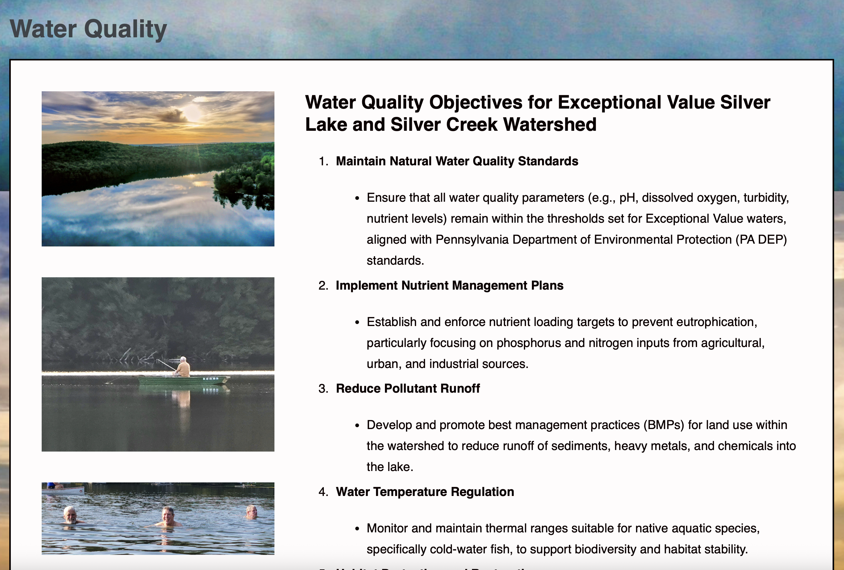
Protecting Silver Lake

Slide 10
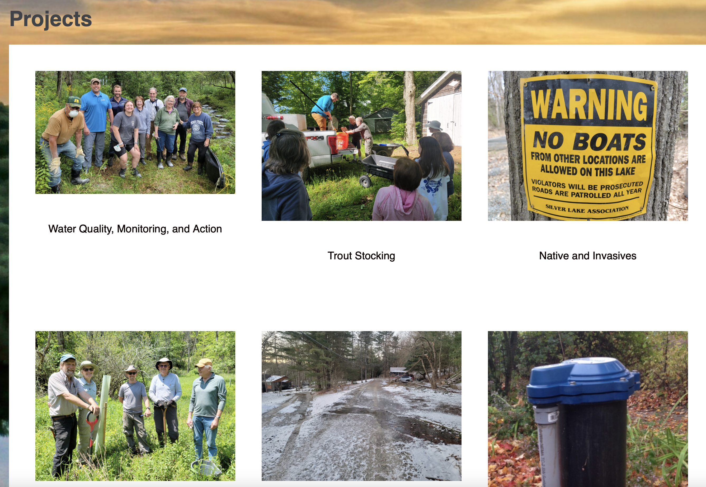
Community Projects

Slide 11
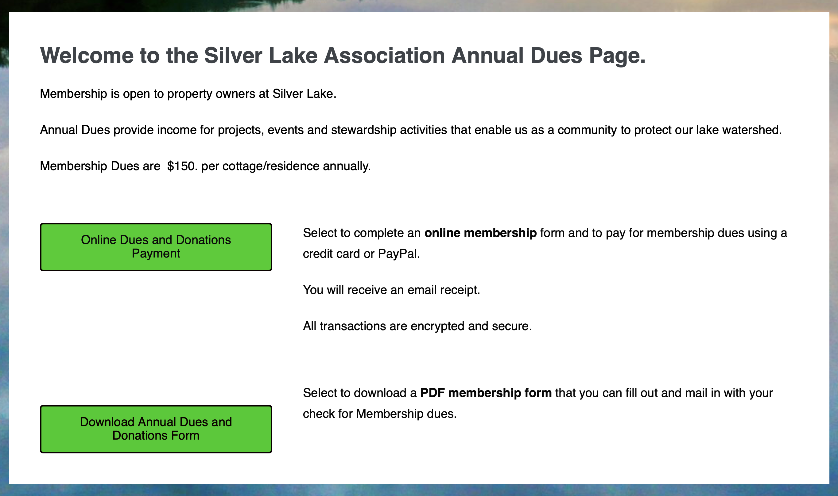
Dues and Donations on-line or by mail

Slide 12
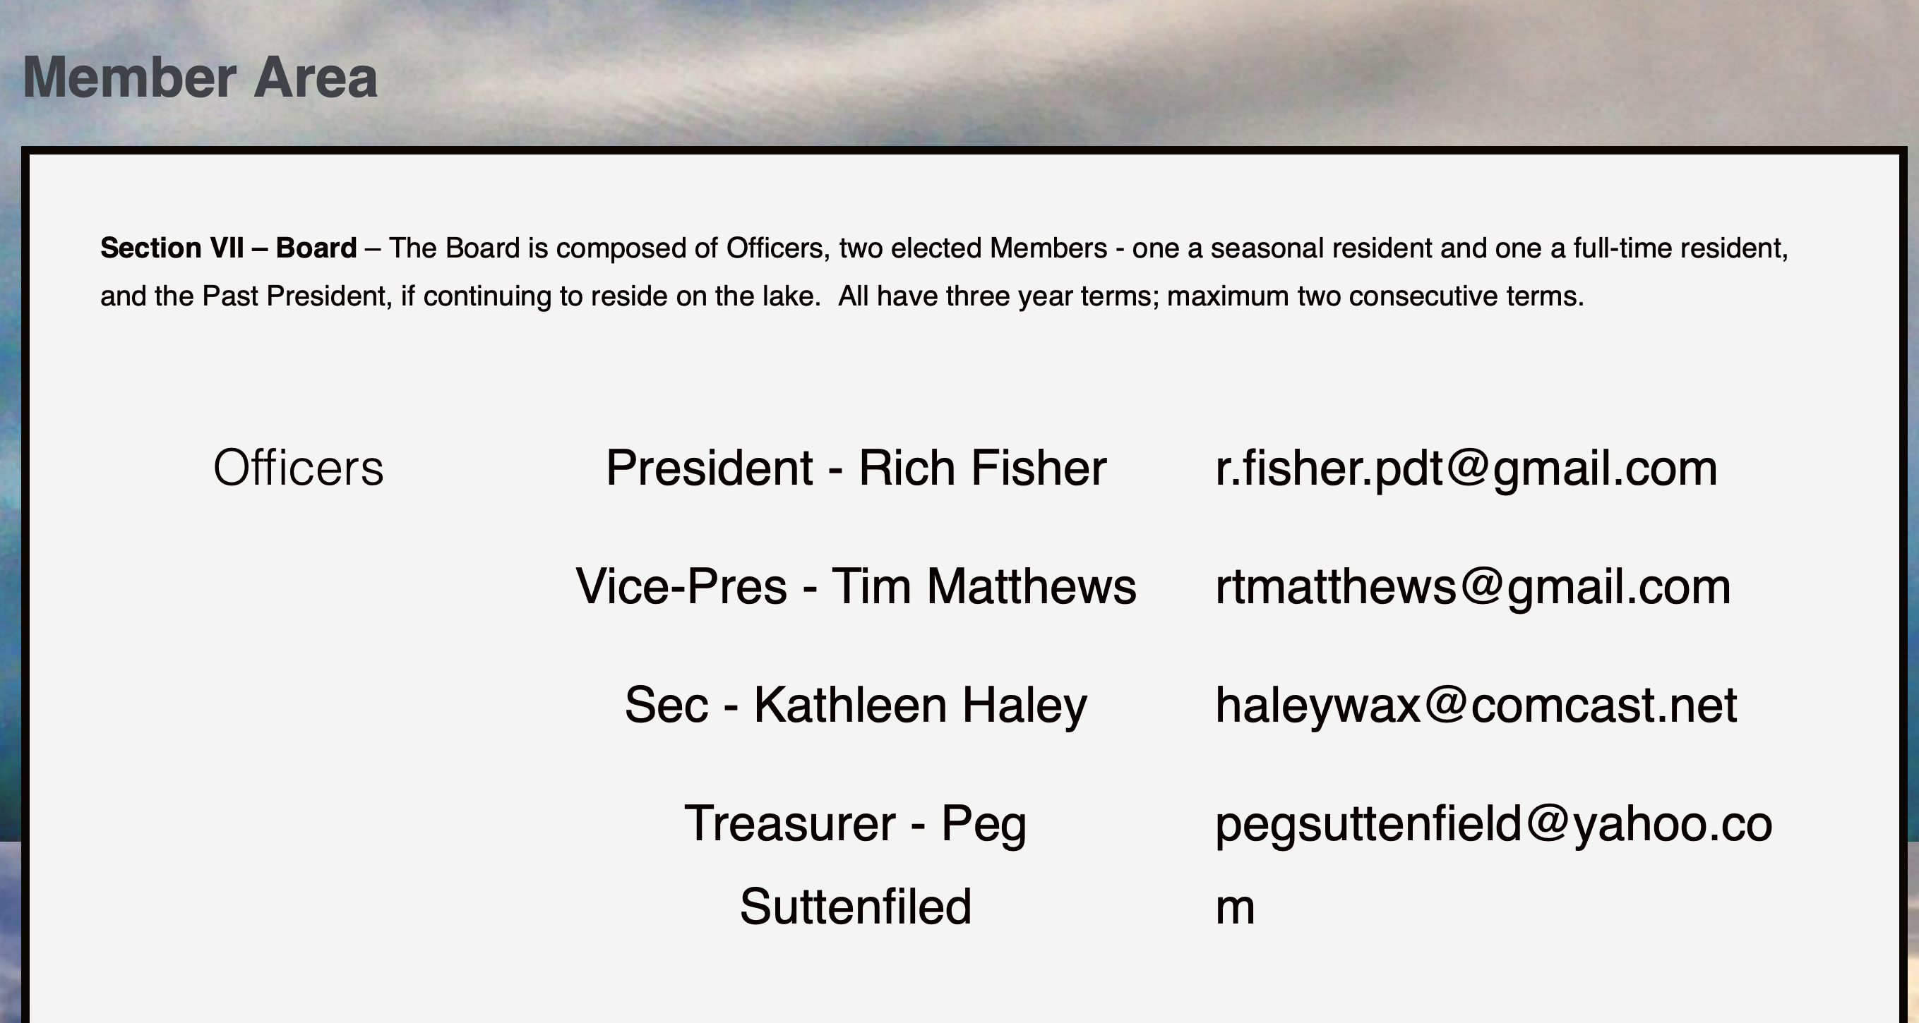
Silver Lake Association Information

Slide 13
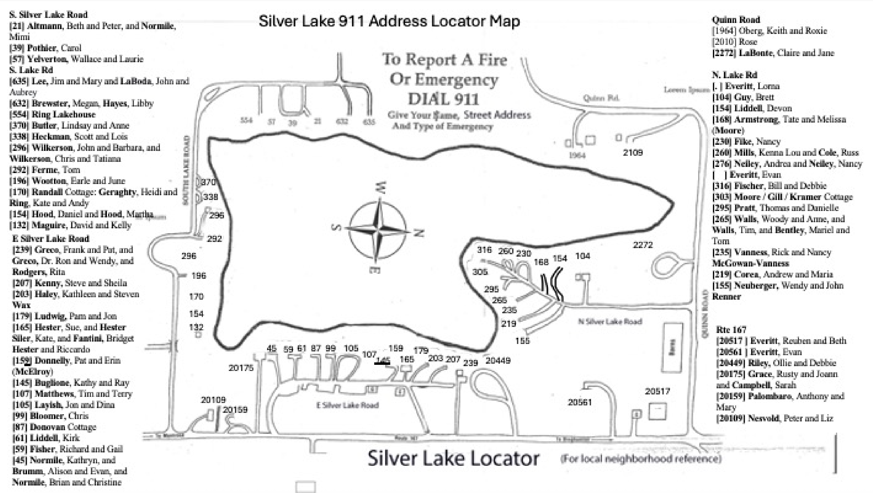
Community Sharing, Health, Safety

Slide 14
The website is a living tool and is available now. With your help the website can become a growing history, archive, and resource
You and your family are encouraged to use the website and add to and share the images, stories, and history of Silver Lake.
silverlakepa.org
Let us know if you have questions or suggestions
Note: There are multiple Silver Lakes; be sure to search for silverlakepa.org

